Slide 1
2023-2024 Guide for Band Parents
Pride. Passion. Perseverance

Slide 2
CONGRATULATIONS! YOUR CHILD IS NOW A MEMBER OF THE RPHS MARCHING BAND AND GUARD!
The first year as a high school band parent is very exciting. Being a member of the band program requires hard work, discipline, and great time management skills. In this guide, we hope to give you and your student the tools that you will need in order to have a successful, smooth, band experience.
All academically eligible band members will attend football games, marching competitions, and other special events. However, not every band member will have a position in the marching show. Marching spots are assigned at the discretion of the band directors based on attendance, attitude, musical and marching ability, instrumentation and balance, and work / practice ethic.

Slide 3
Band Camp
Band Camp and rehearsals start on July 24th, 2023.
If your student is a guard member, student leader, or a percussionist, they have mini camps during the month of June, and may start earlier in July than the rest of the band!
Attendance and participation is mandatory! To get the best musical product on the field, all band students need to be present at all scheduled rehearsals. See our CHARMS calendar at rpband.org for dates.
Attendance in summer band is a major consideration when the directors determine the starting positions for performers in the marching show!
Band camp starts at 7AM with either music or marching practice. The first week the majority of these rehearsals will be held inside. The second week of camp all morning rehearsals will be conducted outside. Because August is the hottest month of the year, there are a few things to remember so your student remains healthy and hydrated. Rest assured that if they do have problems, booster volunteers are on hand to handle any issues (and we need your help!).

Slide 4
Be Prepared for Band Camp!
Every day of summer band camp, show up for practice with:
Light colored Shirt (NO BLACK, NAVY BLUE, ETC)
Athletic Shorts
Tennis shoes (NO FLIP-FLOPS, SANDALS, OR BOOTS)
Sunscreen
Hat or other head covering
Towel or Beach Towel to set instrument on
Cotton gloves if you are a brass player (white is ok, black is preferred)
Sunglasses
A camel pack -- not required but nice to have!
Purple water jug/Juguzzi (Included in fees and passed out first day of band camp!)
Lunch
Make sure to have a good breakfast and drink plenty of water the day before and at night to stay hydrated
And most important...BRING YOUR INSTRUMENT !!

Slide 5
What does: "Band camp starts at 7AM mean" ?
It DOES NOT mean arrive at 7AM.
It DOES mean your child should be ready and in place to rehearse at 7AM!
Drop them off early so they have enough time to get ready and not be late for rehearsals.
Drop off AND pick up at the Auditorium entrance. Please DO NOT drive to the back and drop off/pick up from there, as rehearsals and set up will occur on the practice parking lot.

Slide 6
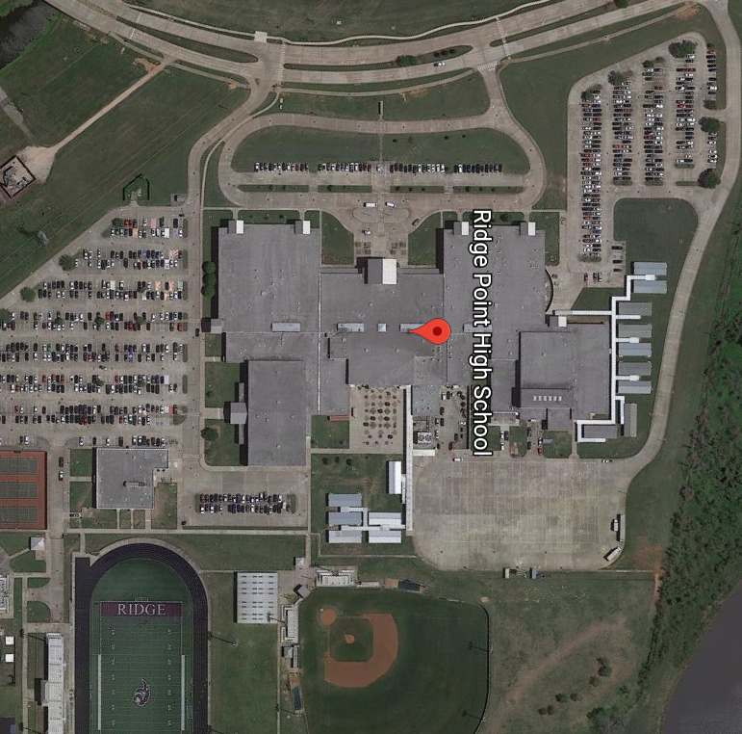
Student Drop-off/Pick-Up for Summer Band
Student Parking
Student Drop Off
Rehearsal Field

Slide 7
Fees
When your child signs up for band, fees are due to cover all costs associated with band. These fees are detailed in the band registration packet and include all the necessary items your student will need. There are several additional costs not included in fees that will occur throughout the school year.
The shorts and t-shirts, along with the uniform we check out to you, will be used throughout the marching season, so proper care of them is expected. We will have shorts and shirts available for purchase if your student loses theirs.
If you have a financial concern, please communicate with our treasurers. The cost of band should not prevent your student from experiencing music. If you need assistance, a payment plan can be setup throughout the year. Also, we do offer some Scholarships to families who can demonstrate financial hardship and meet certain eligibility and service hour requirements.

Slide 8
Time Management
Like so many other worthwhile extracurricular organizations on our campus (Athletics, FFA, Cheerleading, etc.) Marching Band requires a solid investment in time during the school year. When they are not practicing or rehearsing, students should be focused on their schoolwork.
The University Interscholastic League (UIL) dictates many Marching Band Policies such as "NO PASS, NO PLAY".
According to UIL rules, if your child does not pass all their classes, he/she will not be allowed to participate at football games, concerts, or competitions. The directors have no say over academic eligibility. Refer to the UIL eligibility calendar on the fortbendisd.com website for more details. Being ineligible does not excuse a student from rehearsals

Slide 9
THINGS TO KNOW…
ULTIMATE DRILL BOOK: a smartphone application used by the student that utilizes data uploaded by the Directors for our Marching Band Show. The information accessible through this app provides a student with their specific “coordinate” and “drill chart” for learning the drill (formations seen at halftime) to the marching band show. A STUDENT LICENSE for ULTIMATE DRILL BOOK is provided at the beginning of Band Camp to the students as part of their band fees.
PENCILS: always have a pencil on you.
BEHAVIOR AND ATTITUDE: Respect and proper behavior goes a long way. Win with grace. Treat all instruments and property with care. Never make excuses. You are a representative of RPHS Band at all times. Always leave a good impression!
BAND FAMILY: Get to know the other people in your Band Family. You'll find them to be more than just rides to practices and performances. They'll become life-long friends.

Slide 10
THINGS TO KNOW continued…
BAND WEBSITE: The RPHS Band and Guard Website is www.rpband.org. Make sure to check the website often for new information. Most of the music and forms needed for the school year will be found on the website.
EMAIL: We send weekly email newsletters and special updates that contain important information that will help you and your students survive band. Please read these emails, and make sure your spam filter isn't putting them in the junk folder.
CHARMS: Official announcements from the directors are sent via FBISD's Charms email platform and is separate from the weekly newsletter. Please make sure the directors have both your email AND your student's email addresses so you can receive these very important announcements. The official calendar of events is also available via the Charms platform. You can access the calendar by going to www.rpband.org and clicking on "Calendar" in the top right corner of the screen.
SLACK: Our new communication platform for all things band! There is no character limit for announcements, we can have as many channels as needed for our organization, there are not limits to the number of members we can have in the organization or the channels, way less buggy, lots more features. There is a link to join on our Current Students & Parents page.

Slide 11
THINGS TO KNOW continued…
PICKUPS: During marching season, band practice typically ends at 6:00PM. This means they stop rehearsing at 6:00PM but need extra time to put away their instruments and equipment. Student should be picked up in front of the RPHS Auditorium promptly after practices and games. Expect students to come out for pickup about 15 min (depending on how fast your student moves) after practice has ended.
HOME STADIUM: The majority of our football games and stadium rehearsals will take place at either Hall or Mercer Stadium.
FRIDAY NIGHT LIGHTS: Games can be on Thursdays, Fridays or Saturdays, and the students don't get back till late. Directors will inform you on their ETA back home via SLACK
SPIRIT WEAR: Students AND parents can buy Band and Guard spirit wear to show their support.
DONATIONS: The RPHS Band Boosters are a non-profit organization and all your donations or contributions towards fundraisers are tax deductible.

Slide 12
Fall Schedule
After-school practice schedule starts the first week of school. Band members practice three times a week after school until 6:00PM. Football games typically also start the first week of school. We will share the football schedule when it becomes available.
OCTOBER is typically the start of marching competitions, culminating in UIL Marching Contest in late October.
UIL holds area and state marching competition for 6A schools every year now. If the band earns a Division I rating at UIL Regional Marching Competition, it will advance to UIL Area Marching Competition. If Ridge Point is one of the top bands at Area, it will advance to UIL State Marching Competition, typically held in early November.
The band will go to all football games, even after UIL Marching Competition. If the football team makes playoffs, RPHS Band will continue to support them at games. This means "Friday Night Lights" may continue into December!

Slide 13
Winter Activities All-Region/Area/State Band Auditions
All-Region Band is an audition-based group. There are 3 etudes that students will receive in Summer Band Camp to prepare for an audition in December. Student who qualify for the region band earn points toward their letter jacket and will perform in a concert with the finest musicians in the area. If a student places high enough at region, they will qualify to audition at the area level and could in turn qualify for All-State honors. Being selected for All-State Band is the highest individual achievement a high school musician can receive.
9th Grade All-Region Band is an audition-based group restricted to high school freshmen. Students prepare less demanding and smaller cuts of the same All-Region etudes for audition in December. Every freshman is encouraged to audition for this group and can earn letter jacket points through participation. Freshmen that would like to audition for both the 9th Grade and the All-Region bands are encouraged to do so and only pay one entry fee.

Slide 14
Winter Activities All-Region/Area/State Band Auditions Continued…
HS and 9th Grade All-Region Band auditions ARE NOT OPTIONAL for students in the Wind Ensemble and Symphonic Bands. It is highly encouraged that students in the Concert Band also audition.
Portions of the etudes used for All-Region Band Auditions will be used as the material for The Ridge Point Band Spring Placement Auditions (held the week before Thanksgiving holiday break) for the following Spring Semester of the school year.

Slide 15
Winter Activities Continued… Solo & Ensemble
UIL Solo and Ensemble Contest and the Ridge Point Solo & Ensemble Contest are opportunities for students to develop their individual musicianship through preparation of solos and small ensembles.
Music selection and ensemble formation begins in Mid-December. Students should have their music selected before returning from Thanksgiving Break and will be entered into the contest by the end of December.

Slide 16
Winter Activities Continued… Solo & Ensemble Explained (pt. 2)
The UIL Solo and Ensemble Contest is optional and geared toward students that desire to advance to the Texas State Solo and Ensemble Contest. The UIL S&E Contest is currently the only way to earn letter jacket points for solo/ensemble performances in our District.
This contest takes place in Mid-February.
The Ridge Point Solo & Ensemble Contest is our “In-House” contest and is curricular for all RPHS Band Woodwind, Brass and Percussion Students. Participation in this event is mandatory (to a certain degree based upon the ability level band classes) for Ridge Point Woodwind, Brass and Percussion Members. The Ridge Point Solo & Ensemble Contest takes place in Early March.

Slide 17
Winter Activities Continued… Solo & Ensemble Explained (pt. 3)
Solos
SOLOS are performed by one musician with a piano accompanist. Students that perform a solo will be expected to pay approximately $60 to their accompanist at the first rehearsal. Students will be adjudicated and given a 1st Division (the highest) to 5th Division rating based on their performance. Students who earn a "1st Division" rating on a memorized Class One (most difficult) solo qualify to compete at State Solo and Ensemble competition held at UT-Austin during Late May. Also, there are a few solo titles for each instrument that are on the “No Memory Required” that can advance without music memorization. This is due to length (longer than usual) of these selections compared to most of the music on the UIL “Prescribed Music List.”
Note: The optional UIL Contest for solo performance is in mid-February and is optional. The Ridge Point Solo Contest (mandatory and curricular) is held in Early May. Students can only perform in one (unless asked by a director) ensemble per contest.
Ensembles
ENSEMBLES are performed by 3-6 musicians. Please pick your ensemble carefully. Make sure that all the members have the same ideas regarding rehearsals and maintain eligibility through solo and ensemble contest. To qualify for State Solo and Ensemble, the ensemble must earn a "1 " rating on a Class One ensemble (need not be memorized).

Slide 18
Winter Activities Continued… Solo & Ensemble Explained (pt. 4)
Participation in S&E Contest
Wind Ensemble members are required to do both a solo and an ensemble for the Ridge Point Solo and Ensemble Contest
Students in Symphonic Band and Concert Band are only required to do a solo for The Ridge Point Solo and Ensemble Contest.
Participation in the UIL Solo and Ensemble Contest is optional but “highly encouraged” for all members, and can take the place of participating in the Ridge Point Solo and Ensemble Contest.
Fees for the Ridge Point Solo and Ensemble Contest are included in every Woodwind, Brass and Percussion Member’s Fees.
Entry Fees for UIL Solo and Ensemble will have to be paid out of pocket to the RPBB.

Slide 19
^{Concert Season}
Students are placed in level based concert groups within the band program through auditions, past experiences, auditioning for All Region, Solo & Ensemble, rehearsal and performance attendance, attitude, academic eligibility, etc.
Concert season starts when marching season ends, usually with a Holiday Concert in December. Most ensembles compete in UIL Concert and Sight Reading Contests in the Spring. After-school sectionals and full band rehearsals typically start after marching season has ended.

Slide 20
^{Concert Season continued…}
Wind Ensemble is the "Varsity" concert ensemble primarily made up of more advanced musicians / older students.
Members of this ensemble are expected to try out for All-Region, play a solo (Class I) and an ensemble at contest, and are expected to take private lessons.
Symphonic Band and Concert Band are the "Junior Varsity" concert ensembles. They have mostly the same expectations as the Wind Ensemble but are typically younger musicians. Students in these bands are required to perform a solo (Class I, II or III) and/or ensemble and are strongly encouraged to prepare for region auditions.
Students in these bands that aspire to be in Wind Ensemble in the future should strive to meet the same expectations as those in Wind Ensemble.

Slide 21
^{Concert Season continued…}
Jazz Ensemble is an optional classroom ensemble focused on jazz. The Jazz Ensemble performs several concerts throughout the Winter and Spring and competes at Jazz competitions in the Spring. The Jazz Ensemble is comprised of trumpets, trombones, saxophones, guitar, string bass, and percussion.
Full Orchestra (every other year) is an optional after-school ensemble that combines woodwind and brass with the RPHS string orchestra. The Full Orchestra competes at UIL Orchestra competition in the Spring and performs several concerts throughout the Winter and Spring. Positions in the Full Orchestra are earned through audition and participation in the All-Region Orchestra.
Color Guard is the flags, rifles and sabers performance team. Band members may not participate in the Color Guard, due to both Band and Color Guard performing at the same time for the fall marching season. The RPHS Winter Guard competes at several contests in the Winter and Spring, and practices after school; tryouts are held close the end of marching season.

Slide 22
Percussion
Placements for all performing percussion groups are by audition. In both Fall and Spring semesters the percussion students are in percussion class. In the Fall, the two periods of classes are split up by front ensemble(pit) and battery. In the Spring semester, the groups are separated into Symphonic/Concert Band and Wind Ensemble. They also have the opportunity to participate in winter percussion ensembles organized by the percussion director.
The focus in percussion class in the Fall semester is UIL Marching Contest material and TMEA All State Band Audition music. The focus of percussion class in the Spring semester is Solo and Ensemble material, UIL Concert and Sight Reading Preparation, and Percussion Concert material.
All academically eligible percussion students participate in these events: TMEA All State Audition preparation, RPHS/UIL Solo and Ensemble, Annual RPHS Percussion Concert, and all RPHS marching band and concert band contests.

Slide 23
Student Leadership
The student leadership team is typically comprised of older students and more mature musicians. Should your student have any questions or concerns, they should seek out one of these students. The leadership of the band looks like this:
Directors: Mr. Weingartner, Mr. Baños, Mrs. Marquart, and Ms. Blanchard
Drum Majors Captains: (Woodwind, Brass, Perc. & Guard) Section Leaders
If there is an issue, please have your student start with their section leader, then the captains, etc. Always feel free to email the Directors if you have a question that cannot be answered by these leaders and/or the Booster Board. Eric.Weingartner@fortbendisd.com

Slide 24
Standard of Conduct
Students are expected to always represent Ridge Point in a first-class manner. Poor behavior, even when not in uniform and not on campus, reflects negatively on the band and guard programs -- and will be dealt with by Mr. Weingartner as appropriate.
Misbehavior can result in demotion, loss of marching position, and even removal from all participation in extracurricular activities.

Slide 25
Parent Involvement
In order for the band to be successful, we NEED your help!!
The Ridge Point Band Boosters is a place where all parents are encouraged to be involved with the band. The Boosters hold monthly board meetings, and all parents are encouraged to attend. There are MANY ways to help!
Volunteer needs are typically called for in the weekly newsletter and are pointed toward the Sign-Up Genius website. The boosters need dozens of volunteers to support the band's activities:

Slide 26
Parent Involvement continued…
Chaperones: going on the buses with the kids to football games and competitions.
Meal Help: Distribute food to the students before games and contests.
Fundraisers: Fundraising activities help us keep the band fees low. ALL of the students are expected to participate and help with the fundraising.
Pit Crew: This is a group of parents who aid in loading and unloading equipment and instruments for the marching show and help the band set up for halftime.
Uniforms: This is a group of parents who work with the students and the uniforms--inventory, assisting students before game/competitions/performances, fittings for fall and spring uniforms, and all other things related to uniforms!
Sponsorship: This committees seeks to raise money for the Band and Guard via Corporate and Family Sponsorships.

Slide 27
Questions?
This may seem overwhelming, but don't be intimidated. Your child has chosen a rewarding activity that will result in life-long friends. We're here to help. If you have further questions, please contact the Band Directors or the Band Boosters.
Eric.Weingartner@fortbendisd.com
Amanda.Marquart@fortbendisd.com
Christopher.Banos@fortbendisd.com
Gabrielle.Blanchard@fortbendisd.com
Info@rpband.org

